Slide 1
Proposals

Slide 2
Why to write a proposal?
to sell an idea persuasively
to persuade an audience to take some form of action: to authorize a project, accept a service or product, or support a specific plan for solving a problem or improving a situation.

Slide 3
Types of Proposals
External
Solicited
Formal
Internal
Unsolicited
Informal

Slide 4
Types of Proposal (Purpose)
Planning Proposal | Research Proposal | Sales Proposal
Offers solutions for problems or suggestions for improvement. Example: The university intake of the year was huge; therefore, the existing cafe is overcrowded. A suggestion to create another cafe in the parking area near gate 3. | Request approvals for any type of study Example: To analyse the increase in employment opportunities of urban students who are familiar with technology. | Offers services or products and how it surpasses the competitors. Example: Proposing vending machines to university to reduce overhead count and cafe crowd.

Slide 5
Structure of a proposal
II. Plan
A. Objectives and Methods
B. Timetable
C. Materials and Equipment
D. Personnel
E. Available Facilities
F. Needed Facilities
G. Cost and Budget
H. Expected Results
I. Feasibility
III.Conclusion
A. Summary of Key Points
B. Request for Action
IV. Works Cited
I. Introduction
A. Statement of Problem and Objective/Project Overview
B. Background and Review of the Literature (as needed)
C. Need
D. Benefits
E. Qualifications of Personnel
F. Data Sources
G. Limitations and Contingencies
H. Scope

Slide 6
Introduction
Your introduction should include two primary sections: (1) purpose and (2) problem. Purpose. tell your readers the purpose of your proposal.
Problem (Needs Analysis). To clarify for the audience why this proposal is important, explain the problems leading to your suggestions.
Sell your idea from the beginning
Demonstrate the need of your project
Tell what needs to be done and how will it be done.
Your qualification for tackling the project

Slide 7
Body/ Plan/ Discussion
Your discussion section should prove that your plan will work by adding enough details for the audience to evaluate its soundness.
Communicate persuasively
Research content for proposal
Organize your content
Use graphics

Slide 8
Conclusions/ Recommendations
Sum up your proposal, providing your readers closure.
Restate the problem, your solutions, and the benefits to be derived.
Recommendation to suggest the next course of action.
Specify the dates in correspondence to the actions/ plan.

Slide 9
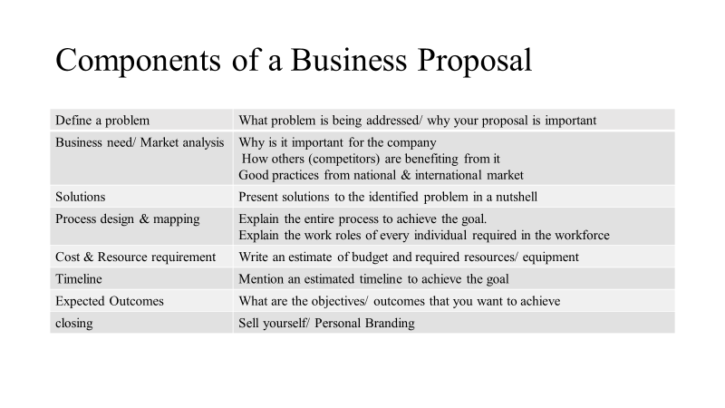

Slide 10
Tips & Tricks
•Propose to the right audience
•Be concise & comprehensive
•Use modes of organization to organize content
•Emphasize on key points (visual aids/ graphs/ charts)
•Include research (market trends/ global practices/ research studies)
•Use the ROI language
•Use of AIDA model

Slide 11
